Slide 1

Aircraft Structural mechanics lab
AE 314/727
Experiment: Laser Doppler Vibrometer
Indian Institute of technology, Bombay

Slide 2
AIM : To determine the natural frequency of given sample
Applications
Aerospace – LDVs are being used as tools in non-destructive inspection of aircraft components
Architectural – LDVs are being used for bridge and structure vibration tests
Hard disk drive diagnostics – LDVs have been used extensively in the analysis of hard disk drives, specifically in the area of head positioning
Biological – LDVs have been used for diverse applications such as eardrum diagnostics and insect communication

Slide 3
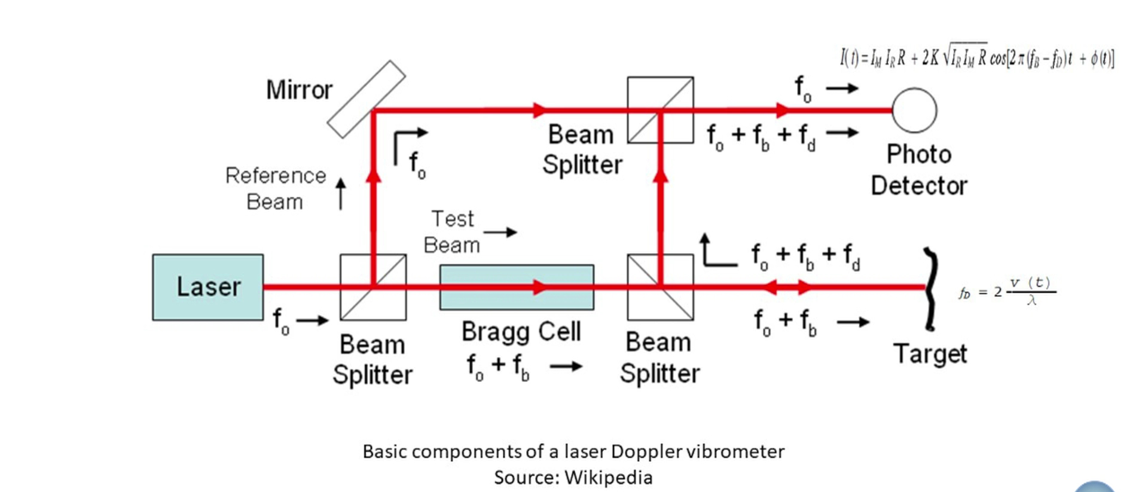
Working Principle

Slide 4
Principle of Operation
A vibrometer is generally a two beam laser interferometer that measures the frequency (or phase) difference between an internal reference beam and a test beam.
The test beam is directed to the target, and scattered light from the target is collected and interfered with the reference beam on a photodetector.
Vibrometers work in a heterodyne regime by adding a known frequency shift (typically 30–40 MHz) to one of the beams which is generated by a Bragg cell / acousto-optic modulator.
Beamsplitter divides the incident beam of frequency f0 into reference and test beam.
Test beam passes through Bragg cell, which adds frequency shift fb, and is then directed to the moving target which further adds a Doppler shift.

Slide 5
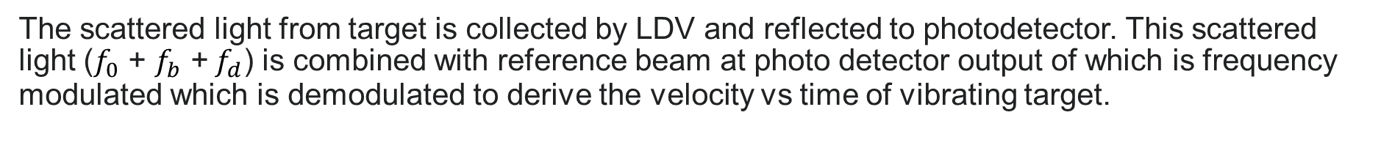

Formula to calculate Doppler shift
$$f_{d}=2∗v\left(t\right)∗cos⁡(α)/λ$$
v(t) is the velocity of the target as a function of time
α is the angle between the laser beam and the velocity vector
λ is the wavelength of the light
The scattered light from target is collected by LDV and reflected to photodetector. This scattered light ($f_{0}$ + $f_{b}$ + $f_{d}$) is combined with reference beam at photo detector output of which is frequency modulated which is demodulated to derive the velocity vs time of vibrating target.

Slide 6
QUESTIONS:
Layout of LDV
Explain interfere pattern and reason
Explain the principle of LDV.
How does a Bragg cell works and state its application in LDV
Explain FFT in the context of vibration

